Slide 1
Design and Analysis of Algorithms
Growth of Functions(Ch3)

Slide 2
Design and Analysis of Algorithms
Growth of functions
Topics:
Growth of functions
O/Θ/Ω notations

Slide 3
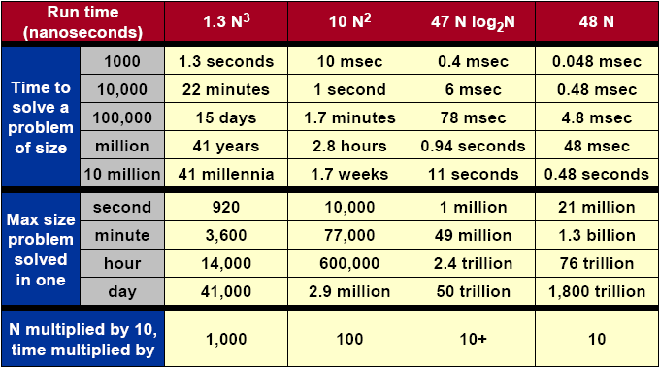
What Does It Matter?

Slide 4
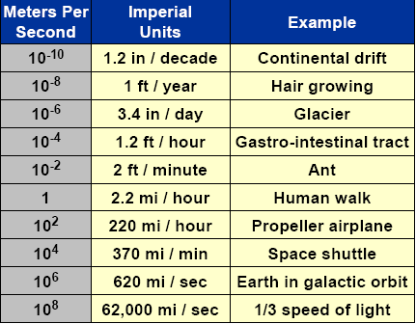
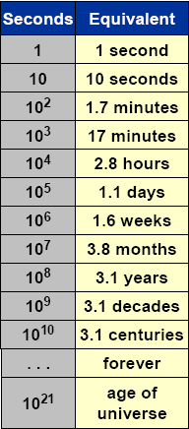

Orders of Magnitude
Notes:
Glacier：冰河
gastro-intestinal：胃肠，tract：组织
Propeller：推进者, 推进物, 尤指轮船, 飞机上的螺旋推进器
Shuttle： 航天飞机
Galactic：银河的，极大的

Slide 5
Asymptotic Growth
In the insertion-sort example we discussed that when analyzing algorithms we are
--interested in worst-case running time as function of input size n.
--not interested in exact constants in bound.
--not interested in lower order terms
A good reason for not caring about constants and lower order terms is that the RAM model is not completely realistic anyway (not all operations cost the same).

Slide 6
Asymptotic Growth
We want to express rate of growth of standard functions:
--the leading term with respect to n.
--ignoring constants in front of it
>>k₁n + k₂ ~ n
>>k₂nlogn ~ nlogn
>>k₁n² + k₂n + k₃ ~ n²
We also want to formalize e.g. that a n log n algorithms is better than a n² algorithm.
O-notation (Big-O)
--you have probably all seen it intuitively done but we will now done it more carefully.

Slide 7
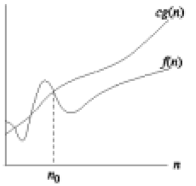
O-notation
O(g(n)) = {f(n): There exist positive constants c and n₀ such that 0≤f(n) ≤cg(n) for all n≥n₀}
--O(.) is used to asymptotically upper bound a function.
--O(.) is used to bound worst-case running time.

Slide 8
O-notation
Examples:
--1/3n² – 3n ∈O(n²) because 1/3n² – 3n ≤cn² if c≥1/3-3/n which holds for c = 1/3 and n >1
--k₁n²+k₂n+k₃∈O(n²) because k₁n² + k₂n+ k₃≤(k₁+|k₂|+|k₃|)n² and for c > k₁ + |k₂| + |k₃| and n≥ 1, k₁n² + k₂n + k₃ ≤ cn²
--k₁n²+k₂n+k₃∈O(n³) as k₁n² + k₂n+ k₃≤(k₁+|k₂|+|k₃|)n³ (upper bound)

Slide 9
O-notation
Note:
--When we say “the running time is O(n²)” we mean that the worst-case running time is O(n²) – the best case might be better.
--Use of O-notation often makes it much easier to analyze algorithms; we can easily prove the O(n²) insertion-sort time bound.
--We often abuse the notation a little:
>> We often write f(n) = O(g(n)) instead of f(n) ∈O(g(n))
>> We often use O(n) in equations: e.g. 2n² + 3n + 1 = 2n² + O(n) (meaning that 2n² + 3n + 1=2n² + f(n) where f(n) is some function in O(n))
>>We use O(1) to denote constant time.

Slide 10
Simple Review
Merge Sort
  MERGE-SORT(A,p,r)
  MERGE(A,p,q,r)
Analysis of Merge Sort－Θ(nlgn), by
  Picture of Recursion Tree
  Telescoping
  Mathematical Induction
Asymptotic Growth
  O-notation

Slide 11
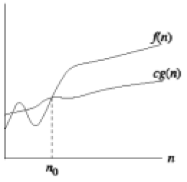
Ω-notation
Ω(g(n)) = {f(n): There exist positive constants c and n₀ such that 0 ≤ cg(n) ≤f(n) for all n≥n₀}
--We use Ω-notation to give a lower bound on a function.

Slide 12
Ω-notation
Examples:
--1/3n² – 3n ∈Ω(n²) because 1/3n² – 3n ≥cn² if c≤1/3-3/n which holds for c = 1/6 and n >18
--k₁n²+k₂n+k₃∈Ω(n²)
--k₁n²+k₂n+k₃∈Ω(n) (lower bound)
Notes:
1/3

Slide 13
Ω-notation
Note:
--when we say “the running time is Ω(n²)” we mean that the best-case running time is Ω(n²) – the worst case might be worse.
--Insertion-sort:
>> Best case: Ω(n) – when the input array is already sorted.
>> Worst case: O(n²)– when the input array is reverse sorted.
>>We can also say that the worst case running time is Ω(n²)

Slide 14
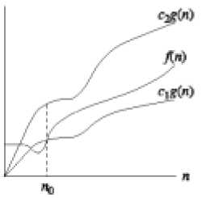
Θ-notation
Θ(g(n)) = {f(n): There exist positive constants c₁, c₂ and n₀ such that 0 ≤ c₁g(n) ≤f(n) ≤c₂g(n) for all n≥n₀}
--We use Θ-notation to give a tight bound on a function.
-- f(n) =Θ(g(n)) if and only if f(n) = O(g(n)) and f(n) = Ω(g(n))

Slide 15
Θ-notation
Examples:
-- k₁n²+k₂n+k₃∈Θ(n²)
--The worst case running time of insertion-sort is Θ(n²)
--6nlgn + √nlg²n=Θ(nlgn)
>>We need to find c₁, c₂, n₀ > 0 such that c₁nlgn ≤ 6nlgn + √nlg²n ≤ c₂nlgn for n≥ n₀.
>> c₁nlgn ≤ 6nlgn + √nlg²n → c₁ ≤ 6 + lgn/√n, which is true if we choose c₁ = 6 and n₀ = 1. 6nlgn + √nlg²n ≤ c₂nlgn → 6 + lgn/√n ≤ c₂, which is true if we choose c₂ = 7 and n₀ = 2. This is because lgn ≤√n if n ≥2. So c₁ = 6, c₂ = 7 and n₀ = 2 works.

Slide 16
Θ-notation
Note:
--We often think of f(n) = O(g(n)) as corresponding to f(n)≤g(n).
--Similarly, f(n) = Θ(g(n)) corresponds to f(n) = g(n)
--Similarly, f(n) = Ω(g(n)) corresponds to f(n) ≥ g(n)

Slide 17
Asymptotic Notation in Equations
Used to replace functions of lower-order terms to simplify equations/expressions.
For example,
4n³ + 3n² + 2n + 1 = 4n³ + 3n² + Θ(n)
= 4n³ + Θ(n²) = Θ(n³)
Or we can do the following: 4n³ + 3n² + 2n + 1 = 4n³ + f(n²)
Where f(n²) simplifies the equation

